Slide 1
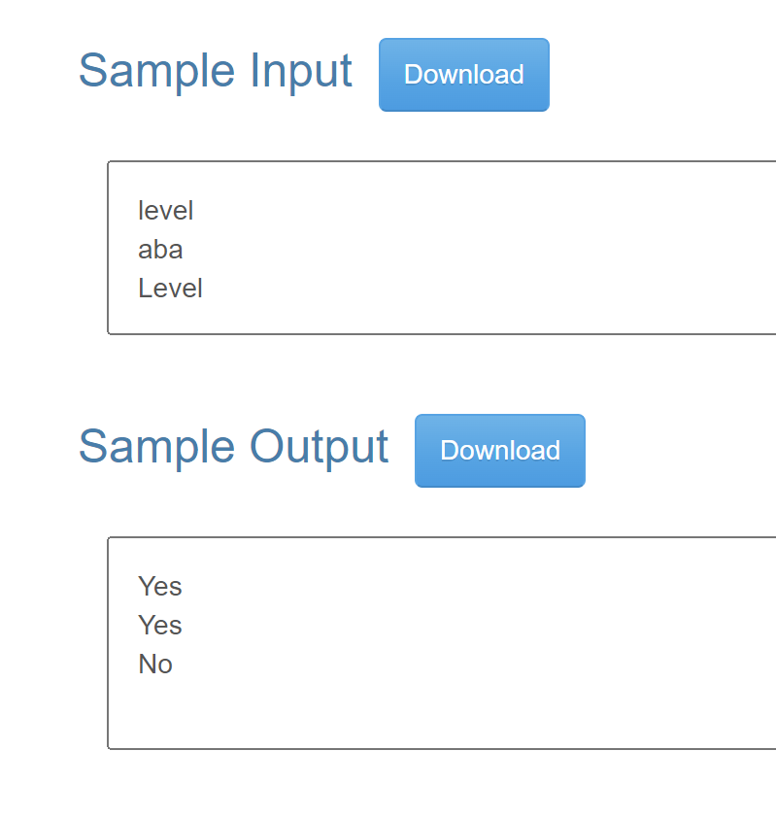
I2P mid practice – Palindrome
Description
Palindrome is a string that is identical to its reverse, like "level" or "aba".
Check whether a given string is a palindrome or not.
Input
The input consists of multiple lines.
Each line contains a string.
The length of each string is less than 100000.
The number of test case is less than 1000.
Output
For each test case, output
"Yes" if it's a palindrome, or
"No" if it's not a palindrome in a line.

Slide 2
I2P mid practice – Palindrome
#include <stdio.h>
#include <string.h>
int main() {
char str[100000];
while(scanf("%s", str)!=EOF) {
int i, j;
int isPalindrome = 1;//a flag
i = 0;
j = strlen(str)-1;
while (i < j) {
if(str[i]!=str[j]) {
isPalindrome = 0;
break;
}
i++; j--;
}
if (isPalindrome)
printf("Yes\n");
else
printf("No\n");
}
return 0;
}

